Slide 1



Building the HCP Journeys
IBD Germany
Pre-Read &
Pre-Work

Slide 2

Preparing for the HCP Journey Workshops - Checklist
Ensuring the HCP Journey Workshops are efficient:
Read and understand the Pre-Read documents
Complete the short Pre-Work Share any relevant documents with the global team that might help in the creation of local Journeys (segmentation, channel research, existing journeys) Evaluate the international adoption ladder for localisation Provide your thoughts on the Key Events and Milestones that are important in the local Jyseleca Journey
Ask any questions to the International team
Ensure the right team members have been invited to the workshop

Slide 3
Pre-Read
(slide 4)
Pre-Work
(slide 37)

Slide 4
Pre-Read

Slide 5

Pre Read
Please read any sections that you haven’t already seen:
The Value of HCP Journeys
Project Overview
The Journey tool (Custellence), and structure
As part of this pack, we have a few chapters of Pre-Reads that are essential to ensure we have a productive workshop.

Slide 6
HCP Journey Workshop Agenda - IBD
Attendees
International team: Patrick, Elisa, Deborah, Geert, Alessandra, Secil, Camille, Clare
Alexandre/Gareth/Alex (Veeva) Arsida/Anjela/Neil/Veronica (DDB) Alice (OpenHealth)
Topic | Format
Team introductions | Roundtable
What we want to achieve | Presentation
Working session: Journey Framework - Events & Key Moments | Interactive Session
Progress Sharing & Tool Demo | Presentation
Working session Review and starting to iterate the local journeys | Breakout Session Groups
Debrief & group discussion | Presentations back to the group
Next steps

Slide 7
HCP Journeys Value Case

Slide 8
A Changing HCP Engagement Model
The traditional methods of engaging with HCPs no longer meets physician needs, and Galapagos aims to engage differently.
Pharma engagement is not meeting the needs & preferences of HCPs.
HCPs want the right information, at their time of choosing, in their preferred channel
>50% find messages in pharma engagements redundant²
<20% find messages are personalized to needs²
1: DT Consulting: The State of CX in Pharmaceutical Industry, 2018
2: PM360: What Physicians Want and Need: Insights from CMI/Compas Media Vitals Research 2019

Slide 9

JYSELECA Launch in the Current Landscape
Galapagos is working in a highly competitive landscape, but has potential to differentiate itself by delivering the right information to each HCP, at the right time, in their preferred channel.
 | The Competitive Landscape — RA & IBD
Competitor | Pfizer | Eli Lilly | Abbvie | Takeda | Janssen | Abbvie | J&J
Brand | XELJANZ | Olumiant | RINVOQ | Entyvio | Stelara | Humira | Remicade
MoA | JAK inhibitor | JAK inhibitor | JAK inhibitor | Monoclonal antibody | IL-12/23 inhibitor | Anti-TNF | Anti-TNF
Indication | RA & IBD | RA | RA | IBD | RA & IBD | RA & IBD | RA & IBD
Non-exhaustive
Galapagos competitors are making significant investments into transformative programmes to deliver personalised HCP engagements – but are making slow progress.
As a newly commercialising business, Galapagos is in a perfect position to get all the right foundations in place quickly, to truly differentiate by delivering on segmented HCP engagements at launch.
Notes:
Sources for Competitive Profiles
- https://www.fiercepharma.com/pharma/pfizer-snags-ulcerative-colitis-nod-for-xeljanz-and-a-broad-label-too
https://www.crohnscolitisfoundation.org/sites/default/files/legacy/assets/pdfs/jak-inhibitors.pdf
https://www.prnewswire.com/news-releases/janssens-stelara-and-pfizers-xeljanz-battle-takedas-entyvio-to-claim-the-preferred-alternate-mechanism-of-action-position-in-inflammatory-bowel-disease-patients-who-are-being-switched-from-their-current-treatment-300777832.html
Lean Organization: Galapagos’ size & structure allows for agile decision-making, more personalized HCP engagement, and greater collaboration amongst functions compared to its large and highly-siloed competitors
‘Innovator’ Status in the Industry: Due to the relative ‘newness’ of Galapagos compared to its competitors, HCPs will likely be introduced to JAK inhibitors & Galapagos at the same time, cementing the perception of a new MoA with Galapagos, an innovator within RA & IBD.

Slide 10








Value of the HCP Journey
HCP Journeys are the tool by which segmented execution is designed, creating value for customers and differentiation vs competitors.
How HCP Journeys Create Value
How They Enable Launch Execution
Focusing on journeys rather than touchpoints is correlated to higher customer satisfaction & revenue growth1
OC HCP Journeys collect & visualize…
Content
What is being said to an HCP
HCPs satisfied with their journey for a drug & the pharma company’s contribution to it are 2x more likely to prescribe than dissatisfied HCPs.1
Channel
How it is being delivered
Personalization across industries reduces acquisition costs by 50% and increases efficiency of marketing spend by 10-30%.2
Adoption Ladder
When it should be said
Segmentation
How this varies between HCPs
Customers gain the ability to see the right information at the right time, in their preferred channel
…Into one executable view
McKinsey - From product to customer experience: The new way to launch in pharma
McKinsey- Marketing’s Holy Grail: Personalization at Scale

Slide 11
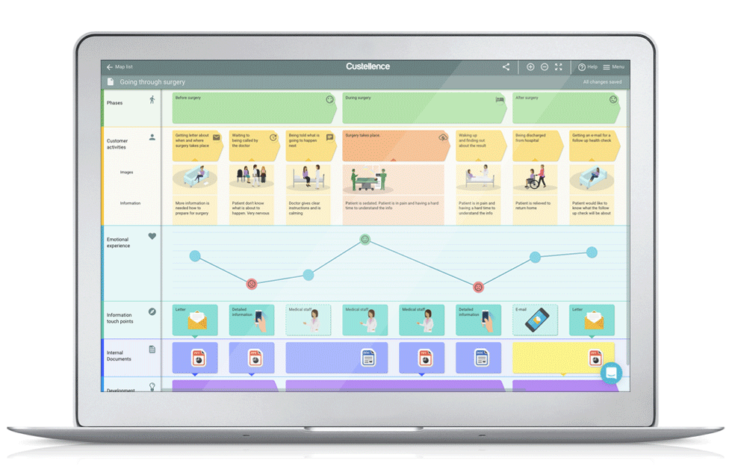

Value of the HCP Journey
HCP Journeys are also an effective way to align the sales, marketing, and medical functions effectively, connecting strategy to execution.
Marketing+ CI&E
Sales
Medical
They also demonstrate how to leverage the core channels, how to increase the number of touchpoints for improved SOV, and how to connect the physical and digital
Technology Alignment
HCP Journey
Illustrative
Having less resources than many competitors, we need to be much more accurate with our engagements in order to achieve these goals, the HCP Journey helps us to do this.

Slide 12

Why are HCP Journeys needed now?
The implications of not creating HCP Journeys now are substantial
Decreases potential for a successful JYSELECA Launch
Galapagos only has one chance to launch JYSELECA, and the use of HCP Journeys enables personalized HCP engagement, which stands as the best opportunity to differentiate against Galapagos’ heavily resourced competitors.
Prohibits intelligent marketing advancements
Clear and consistent HCP Journeys are the foundation of more advanced marketing techniques:
One message for all → Segmentation → Dynamic Channel Personalisation → Next Best Action → Automation

Slide 13
HCP Journeys Project Overview

Slide 14

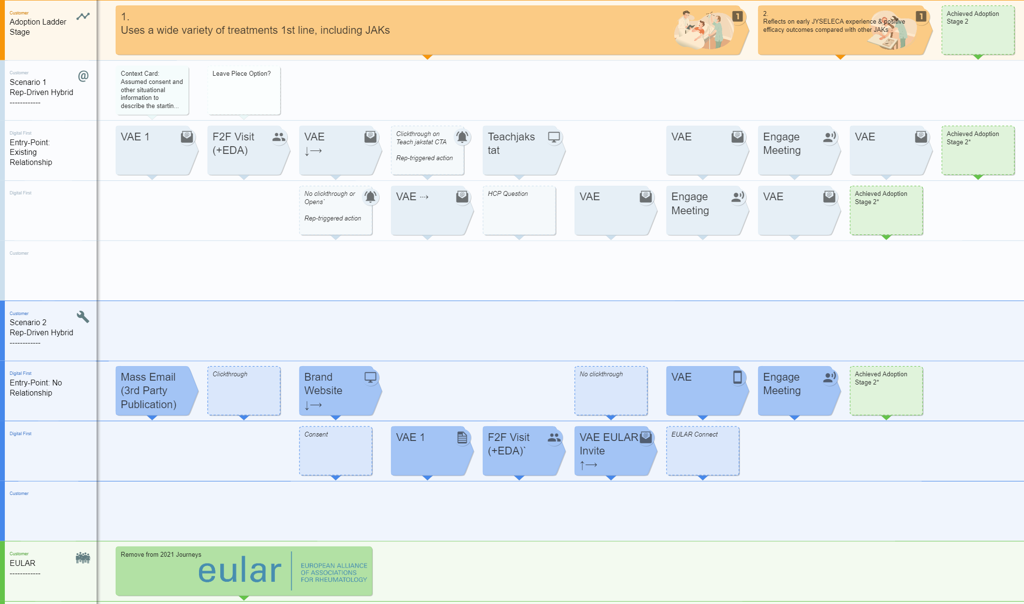
What is the HCP Journeys Project?
A cross functional team is now making strategy a reality, by creating HCP Journeys that bring together existing content, OC channels and research…
…into maps to guide the rapid movement of HCPs through stages in the adoption ladder.
Illustrative example

Slide 15







The International Team
The core international team is comprised of the following cross-functional team members:
The HQ Team
The External Advisors
Patrick, Elisa & team – Brand
DDB – Content
Secil Basoglu – Omnichannel
Alice – OpenHealth
Camille Hoffman – Market Research
Veeva Business Consulting – Project Orchestration
Clare Blakey – Training
The Extended Team
Additional support & insights provided through the project by Medical, Market Access, & Launch Excellence
Johan Siverstrand – Sales Force Effectiveness

Slide 16

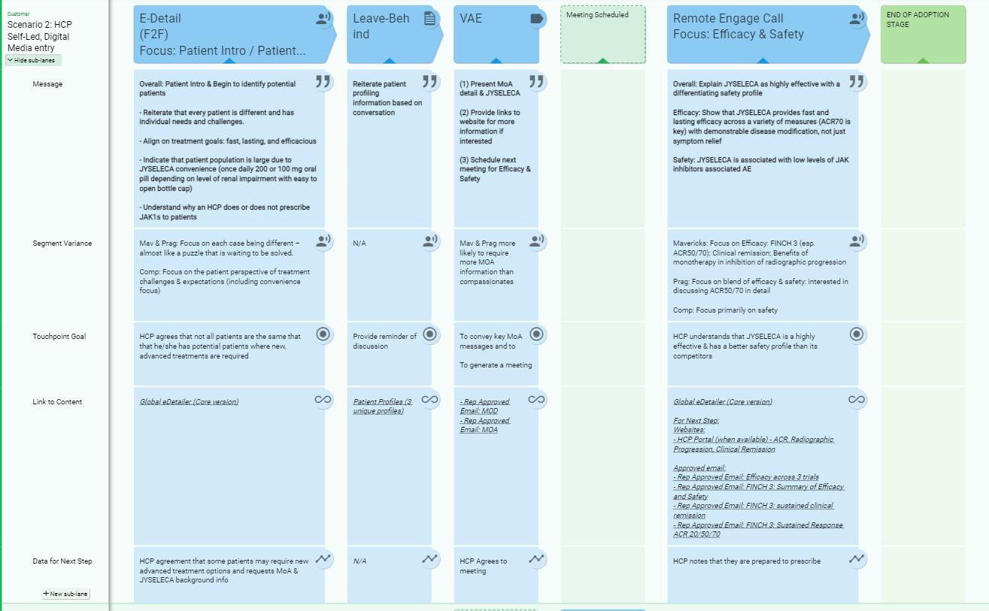
What will you get at the end?
A clear Customer Journey for your market, for the IBD indication, linked to driving HCPs up the initial stages in the adoption ladder
Journeys that are linked to content both existing and currently in production for launch, with easy access to the materials needed for execution (and view on planned content)
An easy-to-use Customer Journey format, to enable dynamic updates throughout the year

Slide 17
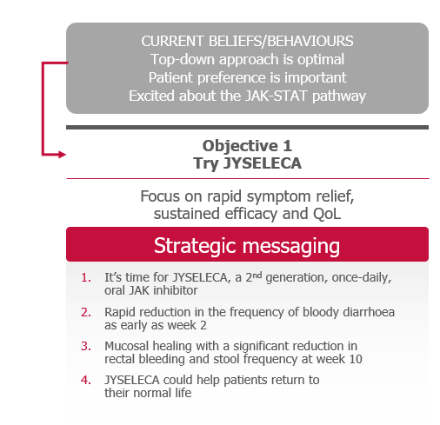
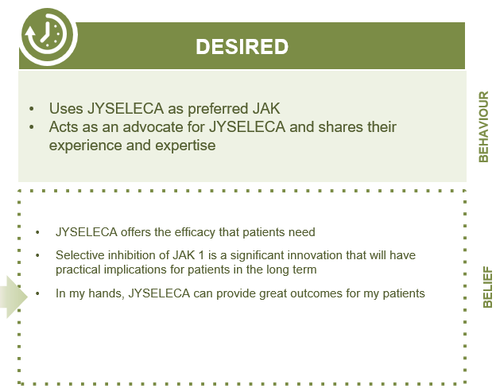
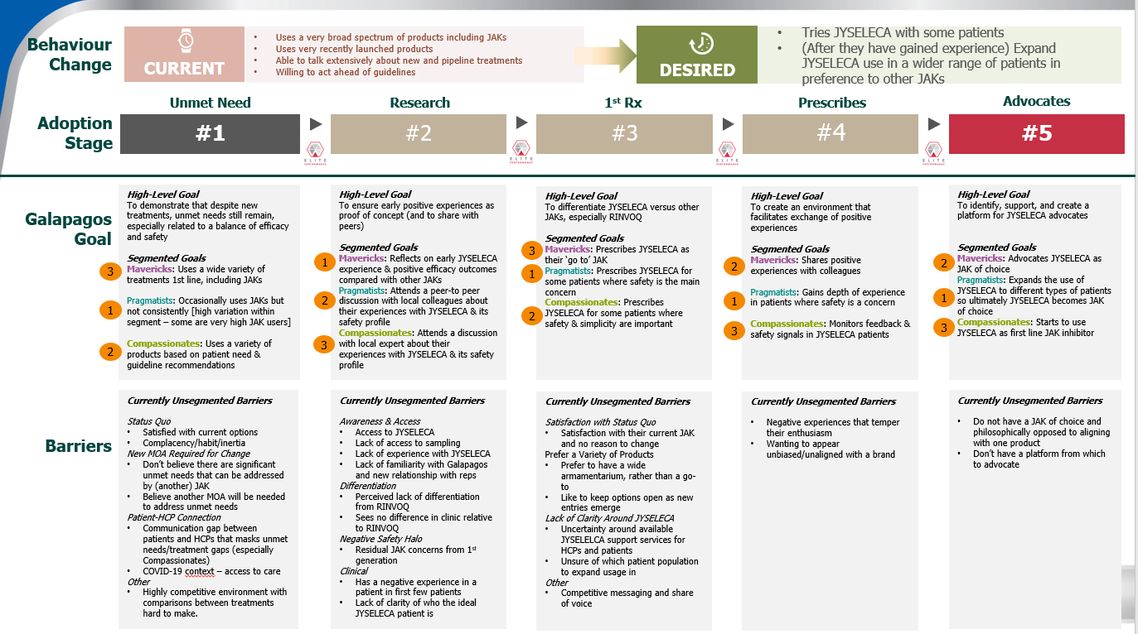



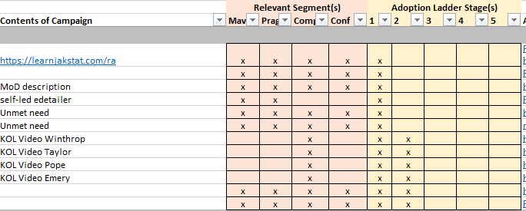

The Approach is Consistent & Cross-Functional
Brand / Strategy
Brand / Strategy
Marketing / Medical Maps
Leverage existing Strategy
Organise it for market clarity
Develop the Journeys
Research | Segmentation Channels | Content
The execution-focused mapping of the touchpoints with a HCP.
Adoption Ladder consolidation & consistent format
International illustrative Versions
IBD Segmentation
Content alignment to segmentation and adoption ladder stage
Localised executable Versions
Complete
In progress
In progress

Slide 18
How we are making this a reality
To reduce market workloads and to maximise outputs, we are working via a localisation model, with heavy support to markets between engagements.
March |  |  | April | April |  |  | May | May |  |  | June
15th | 22nd | 29th | 5th | 12th | 19th | 26th | 3rd | 10th | 17th | 24th | 31st | 7th | 14th | 21st
Leverage existing Strategy
Creation of consolidated, granular Adoption Ladder, to bring clarity to the brand strategy, research and segmentation
International Journey Creation
Creation of a set of scenario-driven customer journeys, to act as the template for localisation
Journey Localisation
Supported localisation of international Journeys
Brand - IBD
CI&E - OC
CI&E - SFE
Germany (RA & IBD)
CRM & Technology
Market Research
Partner Agencies
IBD UK - Sept
RA International Journeys being developed
IBD International Journeys soon to be developed
TBD Smaller Markets (RA & IBD)
Shorter engagements with lighter localisation, leveraging both international and larger market Journeys
3 x 2hr, cross functional market workshops.
With markets supported in the interim for the time-intensive activities

Slide 19

This work would normally require 3 weeks, we offer to streamline to 3 workshops across 2 months
The engagements are spread over 3-4 weeks, and respect local agendas
First Engagement
during MOC meeting (1hr)
Gather market buy-in for project and define joint objectives
Workshop 1 (2hr)
Local adoption ladder finalisation,
Local HCP journeys initiation using International journeys
Workshop 3 (2hr)
HCP journey finalisation.
Local Signoff
International support
International support
International support
International support
Offline Pre-Work (1-3 weeks)
Gathering of local research, segmentation, strategy, context, content and channel preferences.
Workshop 2 (2hr)
Local HCP Journey iteration

Slide 20
Journey Tool Overview

Slide 21
Custellence
After comparing a multitude of tools, we believe Custellence has the best balance of features vs simplicity, with simplicity being key.
Custellence is a simple, 1-page journey creation tool, with collaboration functionality.
We are using Custellence solely to help guide the creation of HCP Journeys, not for use in the orchestration or execution of journeys.

Slide 22
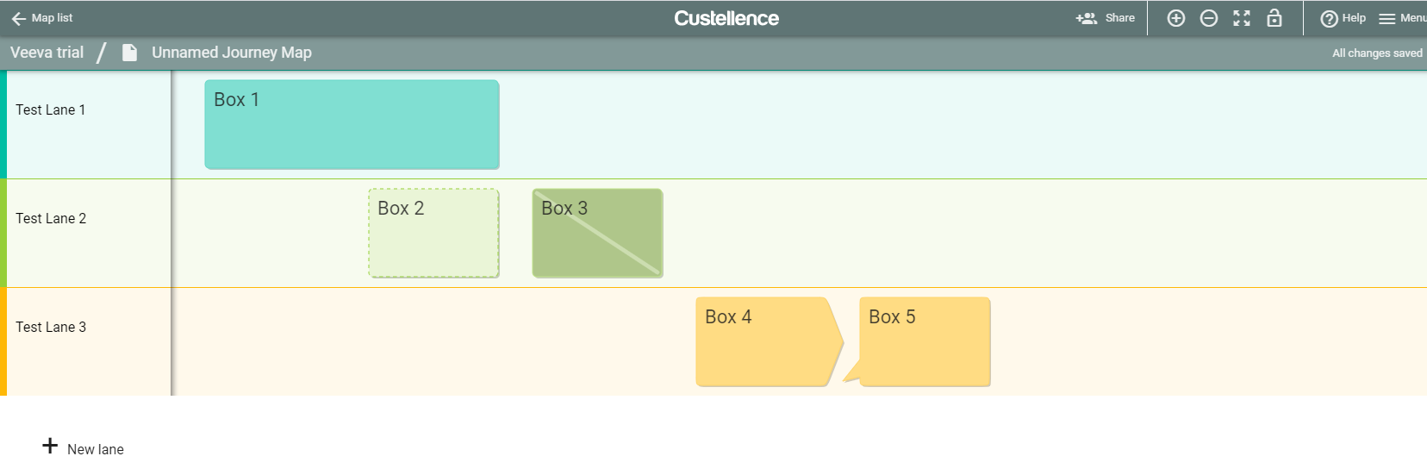
The tool is arranged in ‘lanes’, with boxes
Boxes can be different sizes
Boxes can be assigned different ‘statuses’
Different types of boxes can be added to the lanes

Slide 23
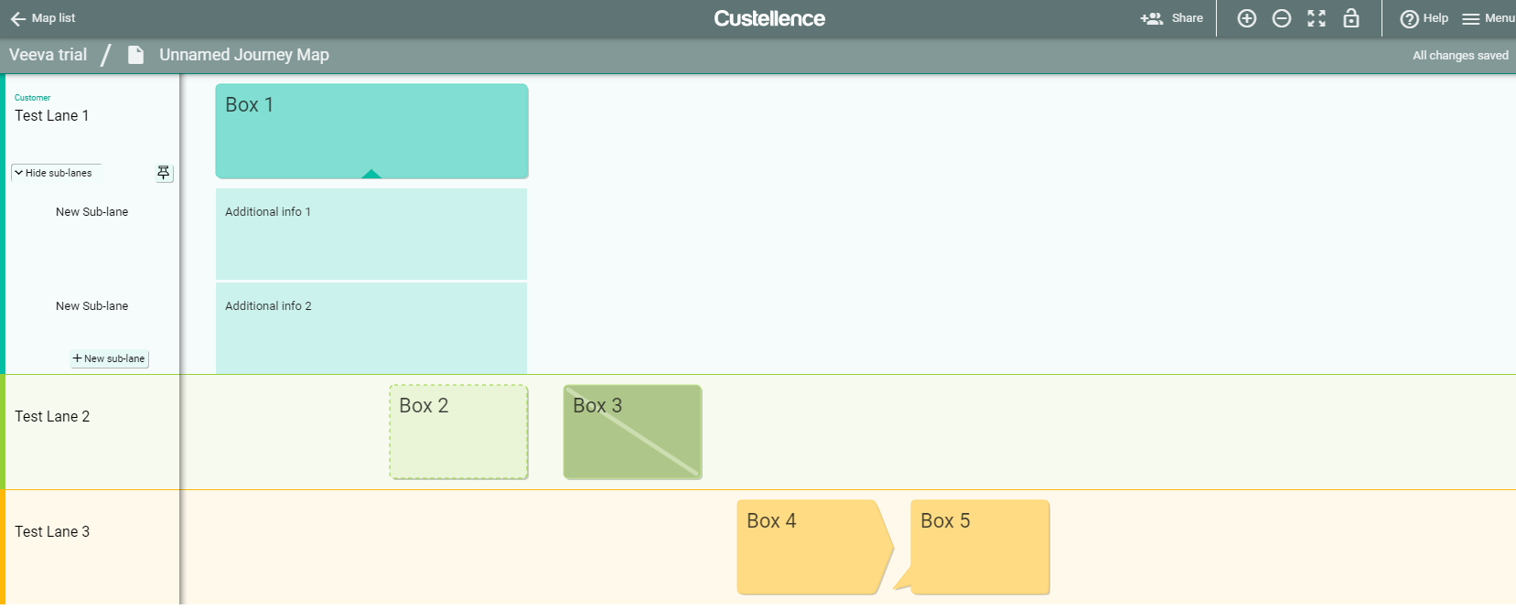
‘Sub-lanes’ can be hidden within a lane
Additional Lanes

Slide 24
Journeys Overview
What the HCP Journeys are
Representations of ways to drive a flow of continued engagement, leveraging the core channels and content
Guidance for connecting channels
Going to be localised to each market based on market channels, content, scenarios and preferences
What the HCP Journeys aren’t
The exact, granular touchpoints for all reps interactions with HCPs.

Slide 25
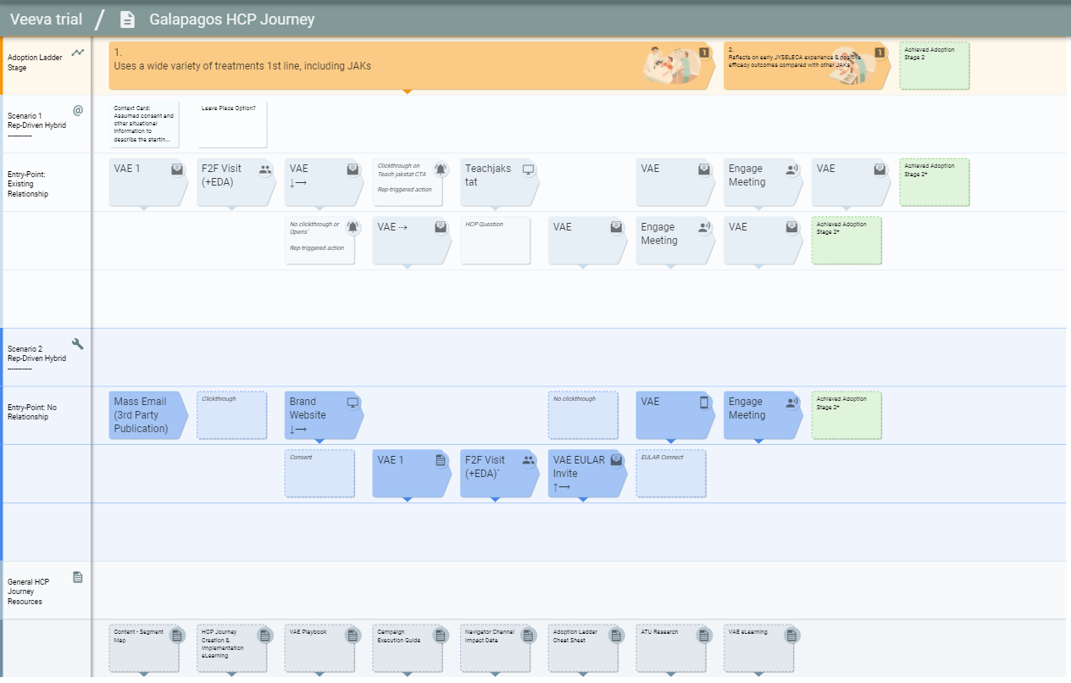
The Journey Map Template
Details

Slide 26




We have defined different box types
Channel boxes are arrow-shaped and the type demonstrated by the box icon/
Other boxes are square and more ‘transparent’, which outlines a connecting action, such as an email click-through or no clickthrough

Slide 27
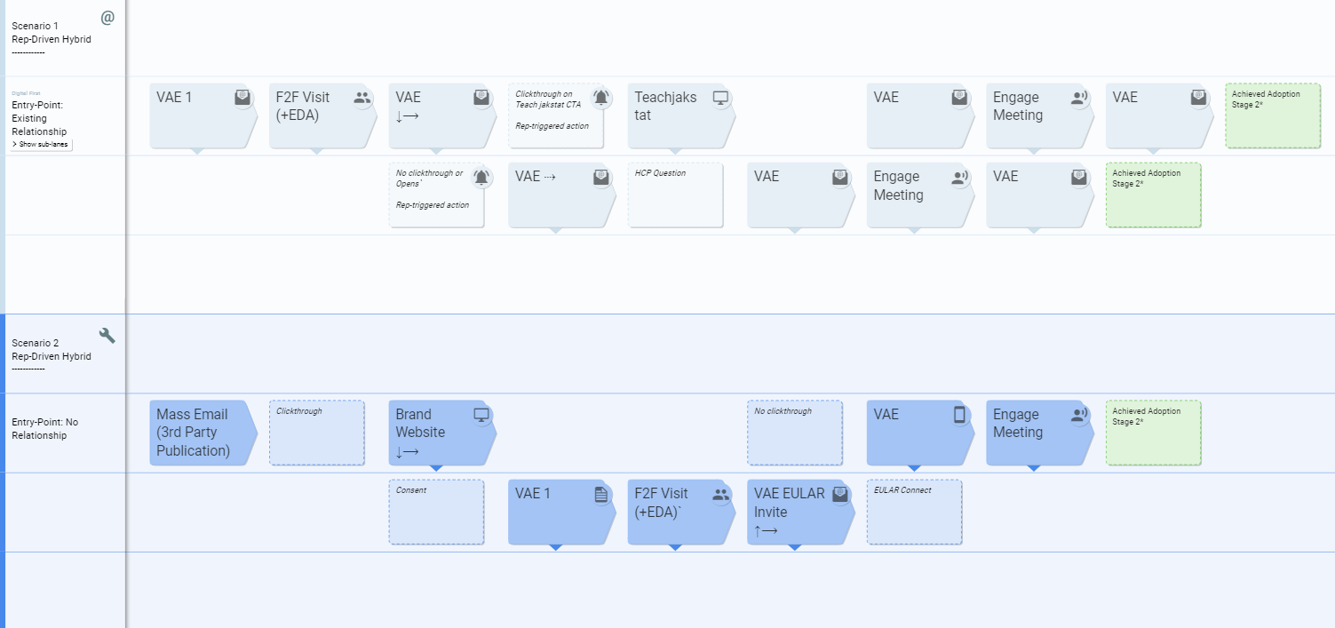
The different scenarios will be colour coded by their lanes

Slide 28
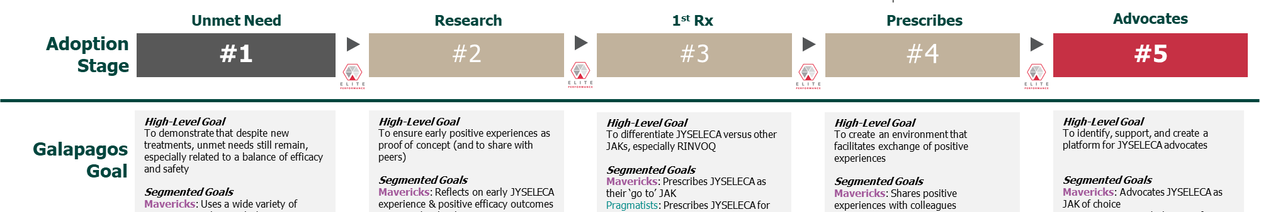
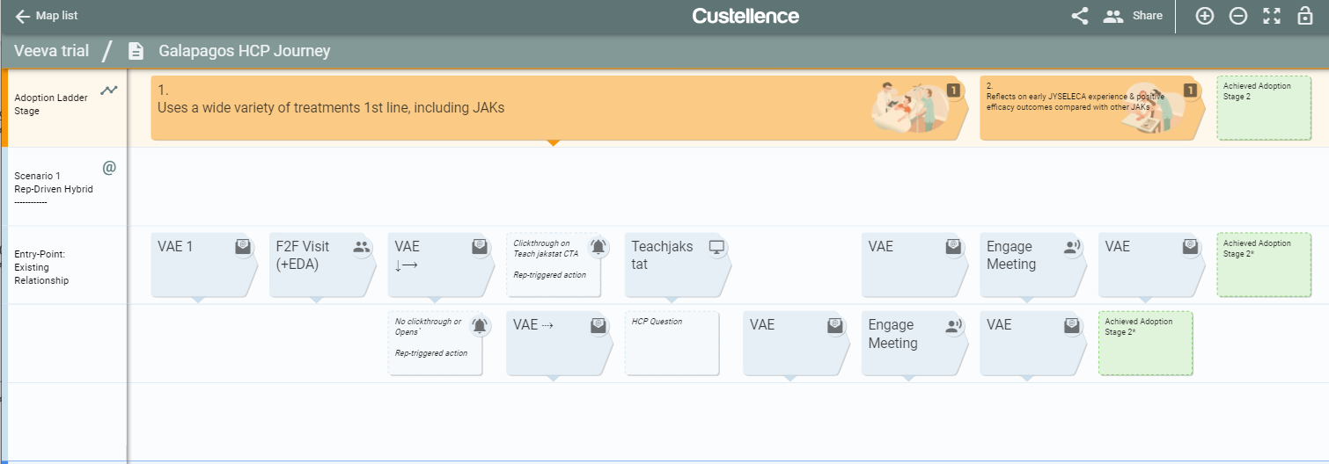
The Adoption stage is highlighted in the top row

Slide 29
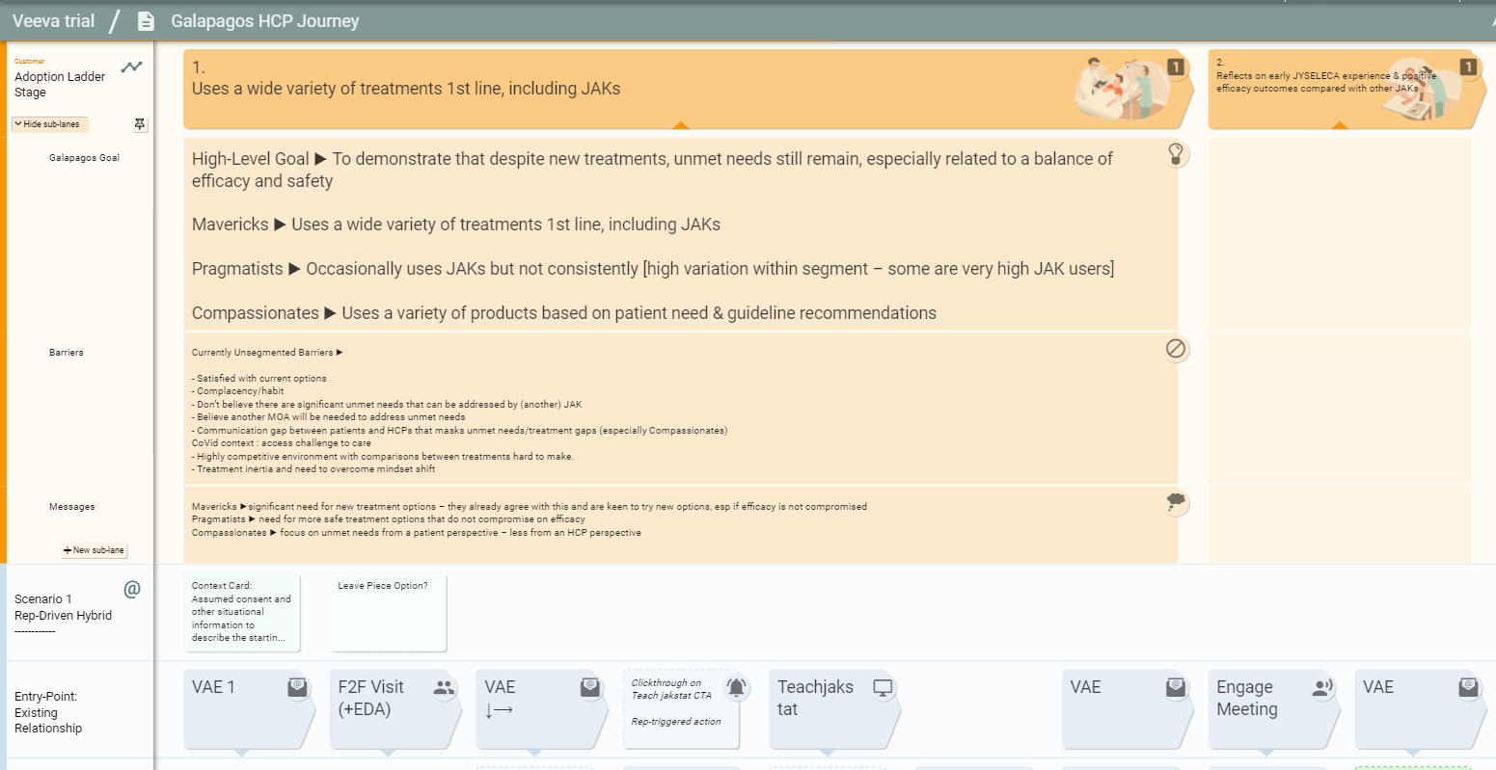
Additional adoption stage detail is hidden in the sub-lanes
Sub-lanes

Slide 30
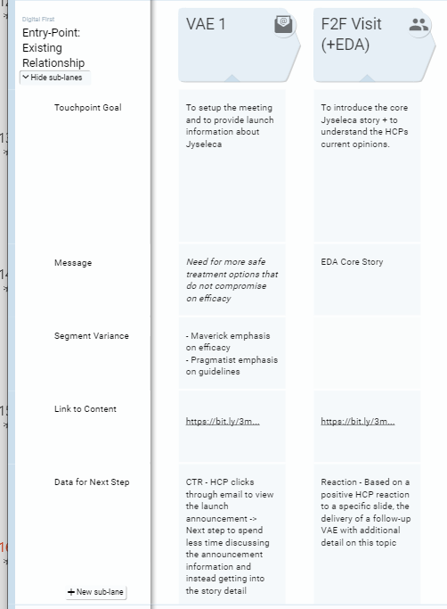
Details about each touchpoint is also hidden in sub-lanes

Slide 31
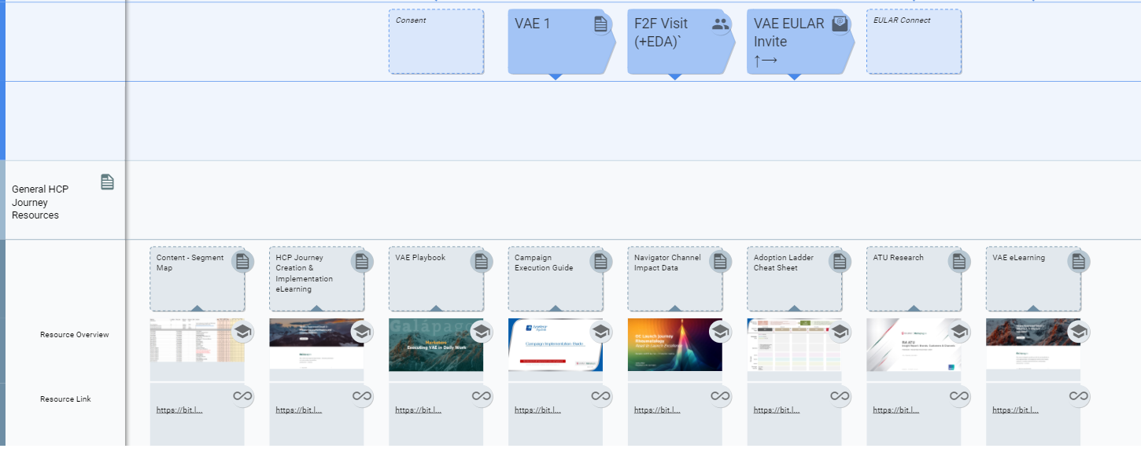
Relevant Resources are linked at the bottom of the map

Slide 32
Pre-Work

Slide 33

Pre Work
Please complete the following actions to ensure the workshop runs efficiently
Share any relevant documents with the global team that might help in the creation of local Journeys (segmentation, channel research, existing journeys)
Review the global Adoption Ladder and provide feedback
Provide your thoughts on the Key ‘Events’ and ‘Milestones’ that are important in the local Jyseleca Journey

Slide 34
Adoption Ladder

Slide 35

For the below adoption ladder
Does this resonate with your market?
What would you change in order to localise it?
What are your questions and feedback?
Please work on the below adoption ladder directly, to begin the localisation, or to combine with your existing documentation.

Slide 36




SCIENCE FIRST
(1 of 2)
Behaviour Change
CURRENT
Behaviour: Uses JAK inhibitors in 2nd/3rd line in a flexible approach. Persists within the same tx class.
Belief: Flexible approach is optimal. Mucosal healing & long-term remission are key treatment goals.
DESIRED
Behaviour: Uses 1st line in bio-naive. Uses JYSELECA as their advanced treatment of choice.
Belief: JYSELECA’s efficacy, safety and convenience data is comprehensive and differentiating. I will identify candidates to trial first line.
Current
Try JYSELECA
Expand Use
Use 2nd Line
Use 1st line in bio-naive
Adoption Stage
#1
#2
#3
#4
#5
Change behaviour from current 2nd/3rd line JAK inhibitor use to JYSELECA 1st line in bio-naive
Identify & trial JYSELECA in a patient who would benefit from a new mode of action and reassured by the mucosal healing & histologic remission achieved
Identify a wider pool of patients who are not adequately controlled & use JYSELECA to achieve mucosal healing & long-term results
Expand usage of JYSELECA as oral, that does not need steroid and provides the depth of sustained remission that they are looking for
Uses JYSELECA as their advanced treatment of choice
Galapagos Goal
Good options now
New MoAs are no more effective
Convenience is not driving long term remission
Barriers
Detailed in steps 2,3,4
Efficacy Messaging Objective: Focus on sustained remission including mucosal healing and CS-free remission
Detailed Messaging:
JYSELECA was evaluated in bio-naïve & bio-experienced patients with highly active disease
Demonstrated significant clinical and complete histologic remission at week 58
First therapy to meet ≥6-month CS-free clinical remission endpoint in a pivotal study
JYSELECA demonstrated significant mucosal healing at Week 58
JYSELECA is affective as monotherapy
Safety Messaging Objective: Highlight new MOA, demonstrated & consistent safety & tolerability profile
Detailed Messaging:
JYSELECA is a JAK1-preferential inhibitor with >5x potency for JAK1 over other JAK isoforms
Demonstrated safety and tolerability profile in UC studies
Low rates of special interest AEs
Low rates of serious AEs similar to placebo & low discontinuation rates (<5%)
Consistent safety profile across 7 studies in RA patients with over 5400 patient years of clinical exposure
Convenience Messaging Objective: Leverage the simplicity of oral ‘away from hospital’ treatment
Detailed Messaging:
JYSELECA is a simple once-daily 200-mg oral tablet
Same dose for induction and maintenance
Minimal monitoring
No immunogenicity and TDM
No infusions or injections
Limited need for hospital visits
Affirm positive experiences with JYSELECA and support use as advanced treatment of choice.
Identify potential advocates and influencers.
Messages
Message Source
Refer to Message Source Slide
Refer to Message Source Slide
Refer to Message Source Slide

Slide 37
SCIENCE FIRST
(2 of 2)
Behaviour Change
CURRENT
Behaviour: Uses JAK inhibitors in 2nd/3rd line in a flexible approach. Persists within the same tx class.
Belief: Flexible approach is optimal. Mucosal healing & long-term remission are key treatment goals.
DESIRED
Behaviour: Uses 1st line in bio-naive. Uses JYSELECA as their advanced treatment of choice.
Belief: JYSELECA’s efficacy, safety and convenience data is comprehensive and differentiating. I will identify candidates to trial first line.
Current
Try JYSELECA
Expand Use
Use 2nd Line
Use 1st line in bio-naive
Adoption Stage
#1
#2
#3
#4
#5
Messages
Efficacy Messaging Objective: Focus on sustained remission including mucosal healing and CS-free remission
Detailed Messaging:
JYSELECA was evaluated in bio-naïve & bio-experienced patients with highly active disease
Demonstrated significant clinical and complete histologic remission at week 58
First therapy to meet ≥6-month CS-free clinical remission endpoint in a pivotal study
JYSELECA demonstrated significant mucosal healing at Week 58
JYSELECA is affective as monotherapy
Safety Messaging Objective: Highlight new MOA, demonstrated & consistent safety & tolerability profile
Detailed Messaging:
JYSELECA is a JAK1-preferential inhibitor with >5x potency for JAK1 over other JAK isoforms
Demonstrated safety and tolerability profile in UC studies
Low rates of special interest AEs
Low rates of serious AEs similar to placebo & low discontinuation rates (<5%)
Consistent safety profile across 7 studies in RA patients with over 5400 patient years of clinical exposure
Convenience Messaging Objective: Leverage the simplicity of oral ‘away from hospital’ treatment
Detailed Messaging:
JYSELECA is a simple once-daily 200-mg oral tablet
Same dose for induction and maintenance
Minimal monitoring
No immunogenicity and TDM
No infusions or injections
Limited need for hospital visits
Affirm positive experiences with JYSELECA and support use as advanced treatment of choice.
Identify potential advocates and influencers.
Message Source / Channel
TS - eDA efficacy pages & leave behind
Email - SF 1 RTE 1
Media - SF 1 banner ad and email
Media – SF 1 journal ad
Web - JYSELECA HCP Portal
SF self-led DA
KOL SELECTION video
FAQ Podcasts
Conference - Exhibition Booth
Medical affairs activities
TS - eDA - MoA/safety pages & leave behind
Email - SF 2 RTE
Media - SF 2 banner ad and email
Media - SF 2 journal ad
Web - JYSELECA HCP Portal
SGF self-led DA
MoA video
FAQ Podcasts
Conference - Exhibition Booth
Medical affairs activities
TS - eDA - convenience pages & leave behind
TS - Patient brochure
Email - SF 3 RTE
Media - SF 3 banner ad and email
Media - SF 3 journal ad
Web - JYSELECA HCP portal
SF self-led DA
Real life patient cases
Conference – Exhibition Booth
Medical affairs activities

Slide 38
HCP Journey Inputs

Slide 39
As part of HCP Journeys, we need to ensure that we are incorporating the core local elements
1. Which are the Key Events we want to incorporate into the journeys?
(EULAR, Key Webinars etc)
2. What are the key ‘Milestones’ in the IBD Journey?
(First Prescription, Patient Identification etc)

Slide 40
Please access the below link and provide your input into these two questions:
Click This Link:
Workshop Pre-Work Survey
or
Go to Slido.com
And enter the code: #IDEIBD

